Slide 1

Introduction to HTML

Slide 2


Slide 3

What is HTML?
HTML stands for Hyper Text Markup Language
HTML is the language used to create webpages. "Hypertext" refers to the hyperlinks that an HTML page may contain. "Markup language" refers to the way tags are used to define the page layout and elements within the page.
Browsers do not display the HTML tags, but use them to render the content of the page.

Slide 4

HTML-Hyper Text Markup Language
Resource for self-study:
https://www.w3schools.com
https://www.khanacademy.org

Slide 5


HTML Tags
HTML tags are element names surrounded by angle brackets:

Slide 6
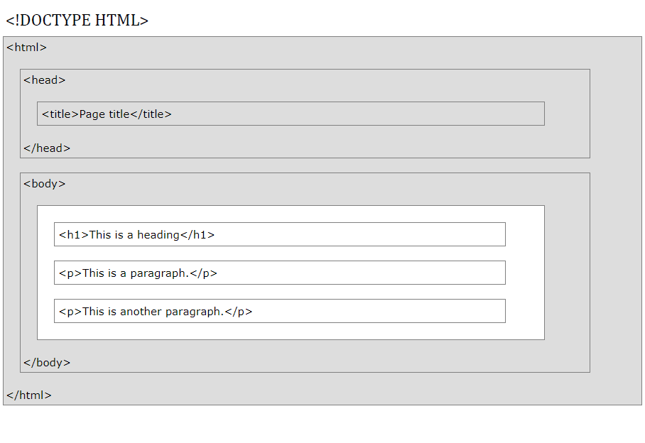
HTML Page Structure
declaration defines this document to be HTML5
element is the root element of an HTML page
element contains meta information about the document
element specifies a title for the document
element contains the visible page content
element defines a large heading
element defines a paragraph

Slide 7

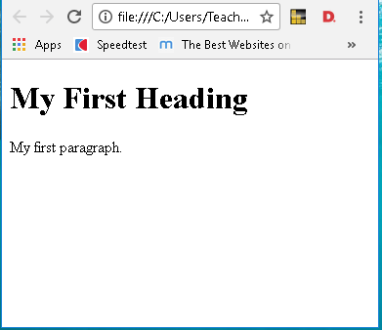
My First Example
Htm, html – file extension for HTML web pages
index.html
<!DOCTYPE html>
<html>
<head>
<title>Page Title</title>
</head>
<body>
<h1>My First Heading</h1>
<p>My first paragraph.</p>
</body>
</html>

Slide 8

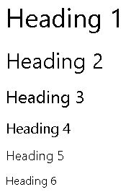
Headings HTML <h1,h2,...,h6> Tags
Headings are defined with the <h1> to <h6> tags.
<h1> defines the most important heading.
<h6> defines the least important heading.
Search engines use the headings to index the structure and content of your web pages.
<h1>Heading 1</h1>
<h2>Heading 2</h2>
<h3>Heading 3</h3>
<h4>Heading 4</h4>
<h5>Heading 5</h5>
<h6>Heading 6</h6>

Slide 9


HTML <br> Tag
<p>
This text contains<br>a line break.
</p>
The <br> tag inserts a single line break.
The <br> tag is an empty tag which means that it has no end tag.

Slide 10
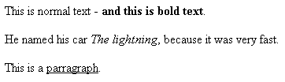
HTML <b> <i> <u> Tags
The <b> tag specifies bold text.
The <i> tag specifies italic text.
The <u> tag specifies underlined text.
<p>This is normal text - <b>and this is bold text</b>.</p>
<p>He named his car <i>The lightning</i>, because it was very fast.</p>
<p>This is a <u>parragraph</u>.</p>

Slide 11
HTML Styles
Use the style attribute for styling HTML elements
Use background-color for background color
Use color for text colors
Use font-family for text fonts
Use font-size for text sizes
Use text-align for text alignment

Slide 12
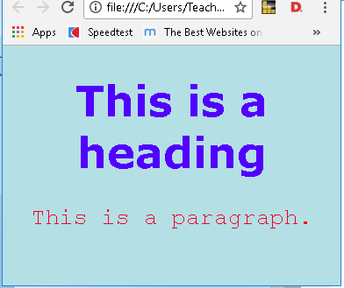
Style Example
<!DOCTYPE html>
<html>
<head>
</head>
<body style="background-color:powderblue;">
<h1 style="color:blue; font-family:verdana; font-size:300%;text-align:center;"> This is a heading</h1>
<p style="color:red; font-family:courier; font-size:160%;text-align:center;"> This is a paragraph.</p>
</body>
</html>

